Slide 1
Big Data GFS, MapReduce, Hadoop, and Spark
Andy Konwinski
2017-10-12, CS186 Guest Lecture, UC Berkeley
Many slides re-used from:
Burak Yuvaz, Databricks. CS186 Spring 2017
Reynold Xin, Databricks. CS186 2016
Matei Zaharia, Databricks. Processing Big Data with Small Programs
Michael Franklin, SQL, NoSQL, NewSQL?. CS186 2013

Slide 2

Who Am I?
Technical Cofounder at Databricks
Co-creator of Apache Mesos
Apache Spark Committer
PhD CS, UC Berkeley; BS CS, U of Wisconsin

Slide 3
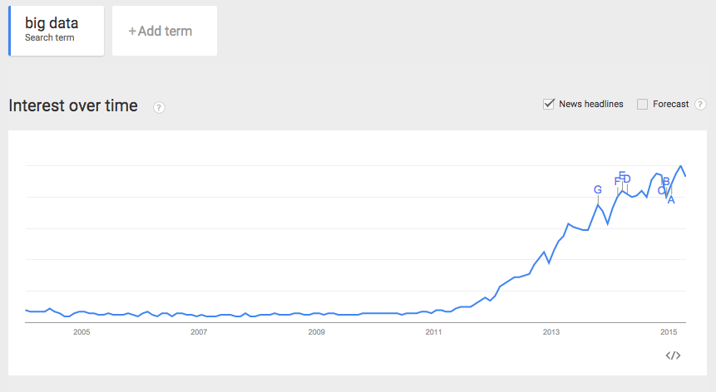

Slide 4
Agenda
What is Big Data?
Motivating Use Cases
GFS, MapReduce, Hadoop
Spark (+demo)
What’s different between Big Data and Databases?

Slide 5
What is Big Data?

Slide 6
Gartner’s Definition
“Big data” is high-volume, -velocity and -variety information assets that demand cost-effective, innovative forms of information processing for enhanced insight and decision making.
“Big data” is high-volume, -velocity and -variety information assets that demand cost-effective, innovative forms of information processing for enhanced insight and decision making.

Slide 7
3+1 Vs of Big Data
Volume: data size
Velocity: rate of data coming in
Variety (most important V): data sources, formats, workloads
Veracity: data cleanliness, completeness, accuracy

Slide 8
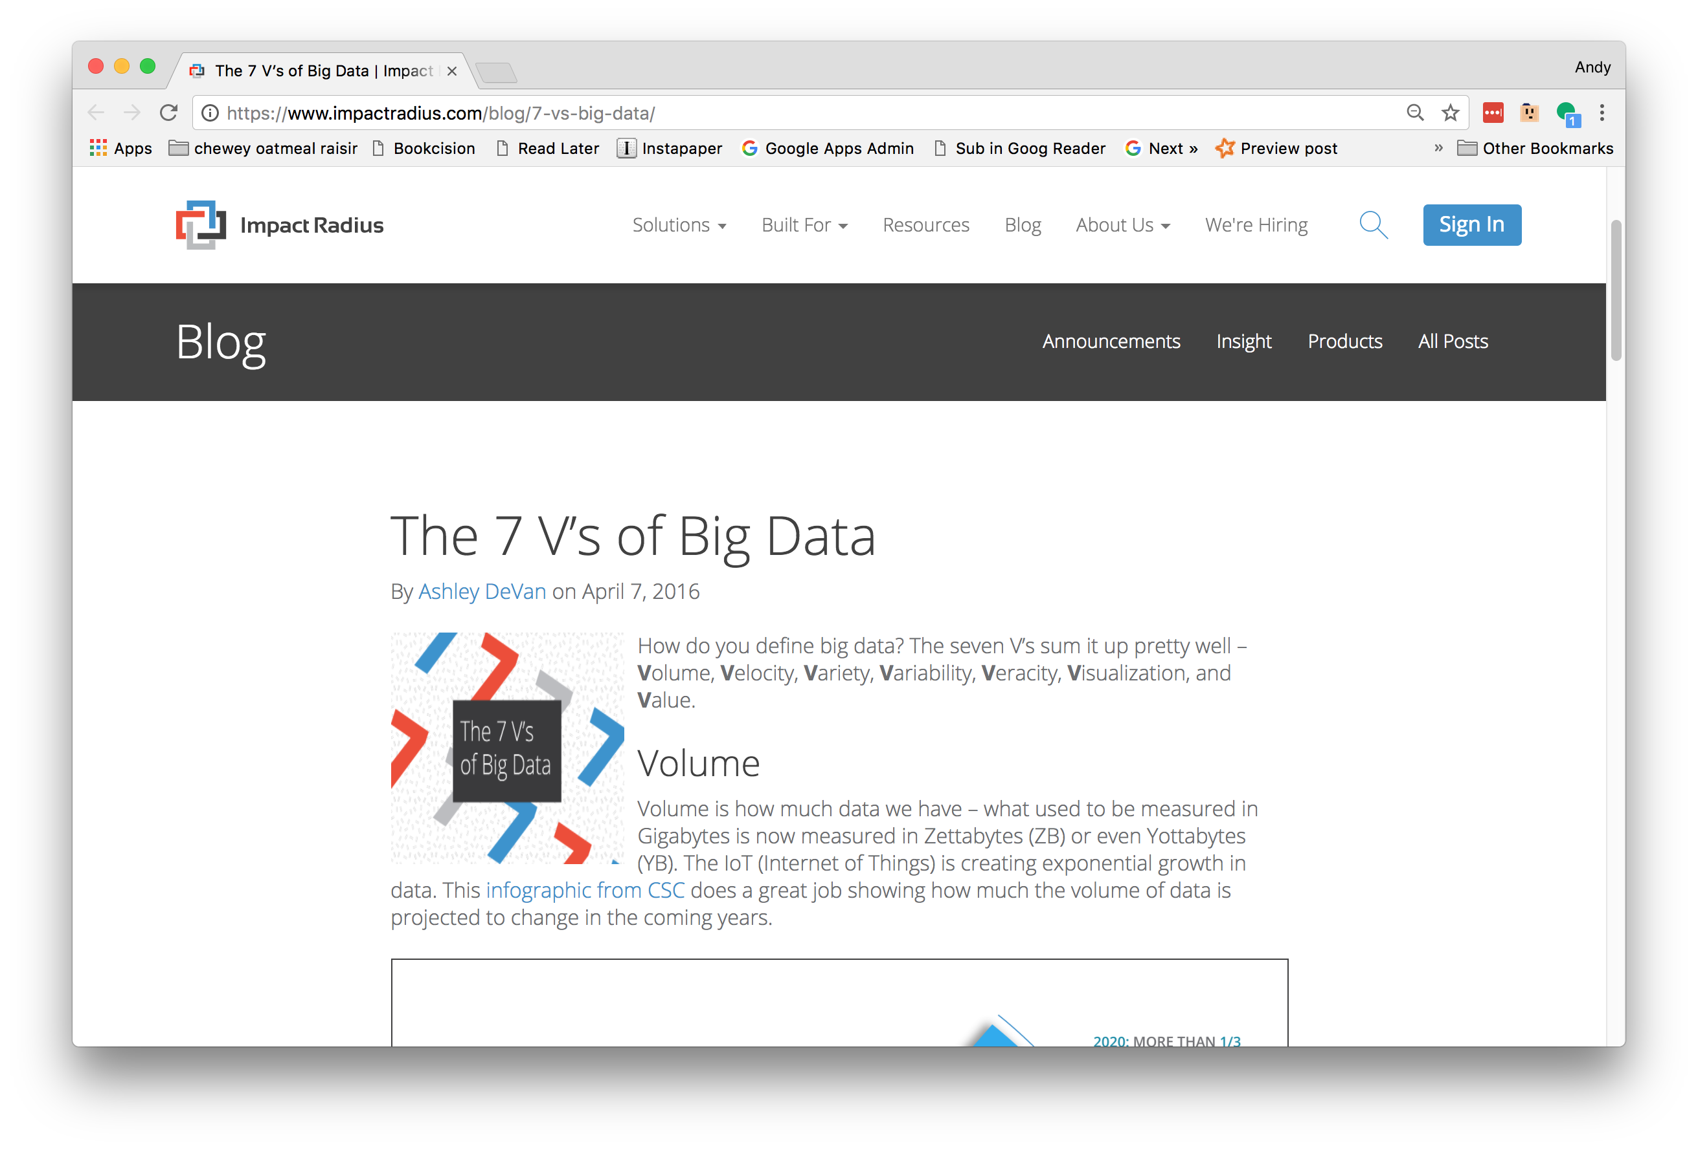
3+1+N Vs of Big Data
Volume: data size
Velocity: rate of data coming in
Variety (most important V): data sources, formats, workloads
Veracity: data cleanliness

Slide 9
Why is Big Data Popular? Valuable?

Slide 10
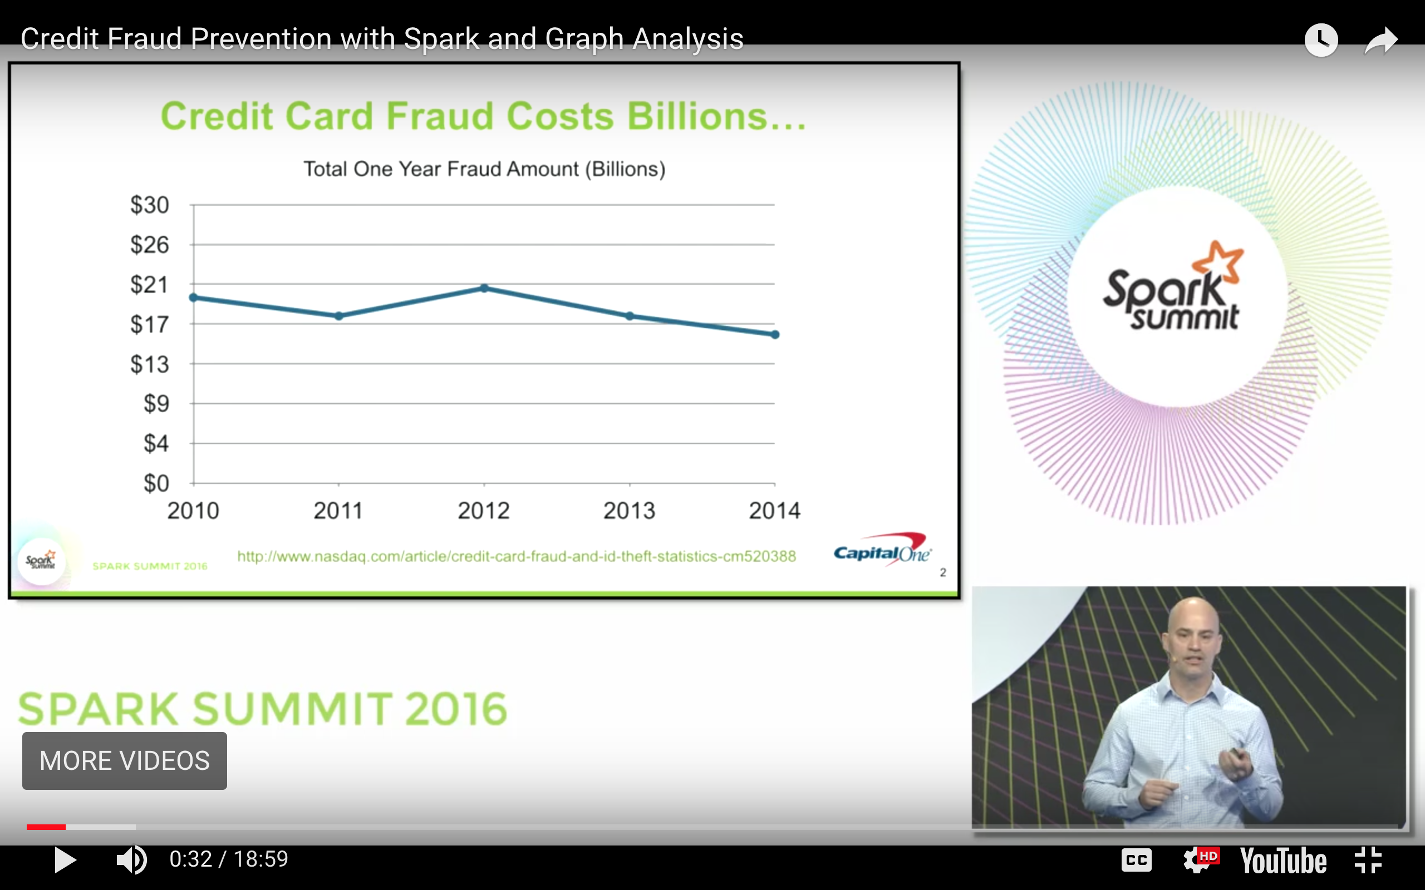
Motivation: Business Use Cases
Security
Fraud detection
Anomaly detection for breaches
Examples:
~$16B/yr lost to CC fraud
~15M victims/yr
CapitalOne detects fraud in real-time

Slide 11
Motivation: Business Use Cases
Machine Learning: Recommendation Systems
Recommend products/social connections/features
Examples:
Riot Games – League of Legends
In-store purchase of outfits/cosmetics for characters. A main profit driver
Identifying unsportsperson like conduct in chat rooms & warning or banning
Hotels.com – recommend hotels/car rentals

Slide 12







Big Data can also refer to the tech stack
Some concepts pioneered by Google

Slide 13
Agenda
What is Big Data?
Business Use Cases
GFS, MapReduce, Hadoop
Spark
What’s different between Big Data and Databases?

Slide 14
History & Roots of Big Data Trend
2003 - Google published GFS
2004 - Google published MapReduce
2006 - Hadoop created
2009 - Spark created (as part of Mesos project)

Slide 15

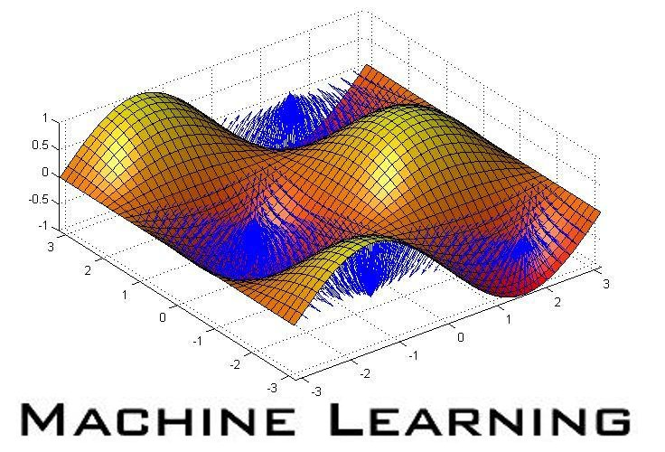
Challenges Google faced
Data size growing (volume & velocity)
Processing has to scale out over large clusters
Complexity of analysis increasing (variety)
Massive ETL (web crawling)
Machine learning, graph processing

Slide 16
Why didn’t Google just use database systems?

Slide 17
Why didn’t Google just use databases?
Cost
database vendors charge by $/TB or $/core
Scale
no database systems at the time had been demonstrated to work at that scale (# machines or data size)
Data Model
A lot of semi-/un-structured data: web pages, images, videos
Programming Model
SQL not a good fit for many Google tasks (e.g. crawl the web, build inverted index, log analysis on unstructured data)
Not-invented-here
Notes:
Also talk about sometimes technology decisions are also partially based on non-technical reasons.
not-invented-here; Google tends to build everything themselves because they view infrastructure as a core competency;
Jeff/Sanjay were not database guys. Google Ads later on had a lot more engineers from database background, and a lot of the ads tech use databases

Slide 18
Examples
Google web index: 10+ PB
Types of data: HTML pages, PDFs, images, videos, …
Cost of 1 TB of disk: $50
Time to read 1 TB from disk: 6 hours (50 MB/s)

Slide 19
The Big Data Challenge
Semi-structured & unstructured data doesn’t fit well with databases
Single machine can no longer process or even store all the data
Only solution is to distribute general storage & processing over clusters.

Slide 20
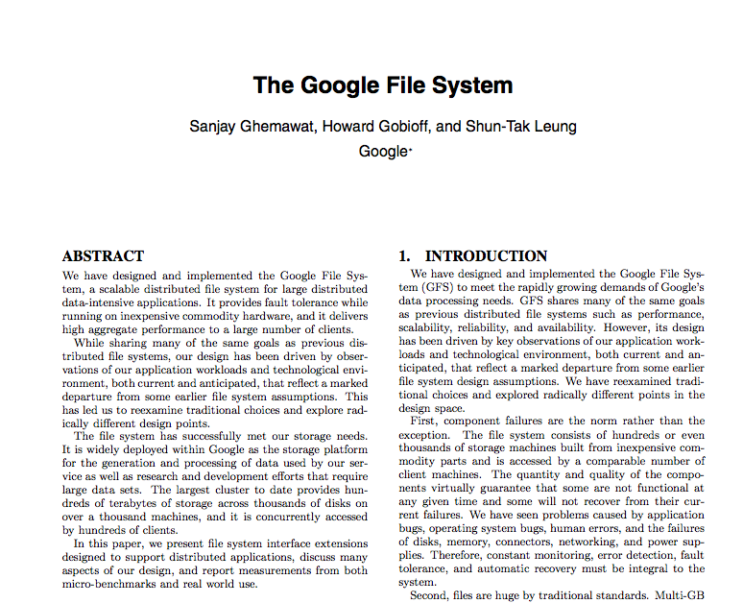
2003

Slide 21
GFS Assumptions
“Files are huge by traditional standards”
“Component failures are the norm rather than the exception”
Files are append-only
“Most files are mutated by appending new data rather than overwriting existing data”
Why is this ok given our workload types?
What are the advantages of this?
Alternative techniques & types of storage systems for when updates required
(Quotes are from GFS paper)

Slide 22
File Splits
Example:
Large File
1100101010011100101010011100101010011100101010011100110010101001110010101001110010101001110010101001110010101001
1100101010011100101010011100101010011100101010011100110010101001110010101001110010101001110010101001110010101001
1100101010011100101010011100101010011100101010011100110010101001110010101001110010101001110010101001110010101001
1100101010011100101010011100101010011100101010011100110010101001110010101001110010101001110010101001110010101001
1100101010011100101010011100101010011100101010011100110010101001110010101001110010101001110010101001110010101001
1100101010011100101010011100101010011100101010011100110010101001110010101001110010101001110010101001110010101001
1100101010011100101010011100101010011100101010011100110010101001110010101001110010101001110010101001110010101001
1100101010011100101010011100101010011100101010011100110010101001110010101001110010101001110010101001110010101001
…
6440MB
Let’s color-code them
Block
1
Block
1
Block
2
Block
2
Block
3
Block
3
Block
4
Block
4
Block
5
Block
5
Block
6
Block
6
Block
100
Block
100
Block
101
…
Block
101
64MB
64MB
64MB
64MB
64MB
64MB
64MB
40MB
Files are composed of set of blocks
Typically 64MB in size
Each block is stored as a separate file in the local file system (e.g. NTFS)
e.g., Block Size = 64MB

Slide 23
Block Placement
Example:
Block
1
Block
2
Block
3
Block
2
Block
2
Block
3
Block
1
Block
3
Block
1
Node 1
Node 2
Node 3
Node 4
Node 5
e.g., Replication factor = 3
Default placement policy:
First copy is written to the node creating the file (write affinity)
Second copy is written to a data node within the same rack
(to minimize cross-rack network traffic)
Third copy is written to a data node in a different rack
(to tolerate switch failures)
Objectives: load balancing, fast access, fault tolerance

Slide 24
GFS Architecture
NameNode
BackupNode
(heartbeat, balancing, replication, etc.)
DataNode
DataNode
DataNode
DataNode
DataNode

Slide 25
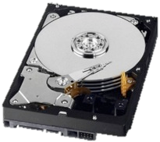
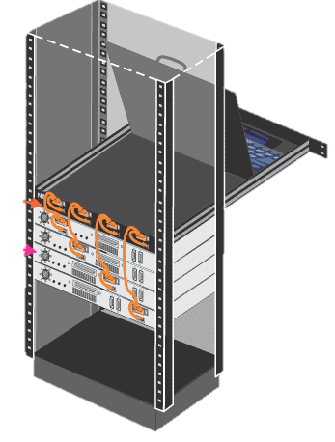
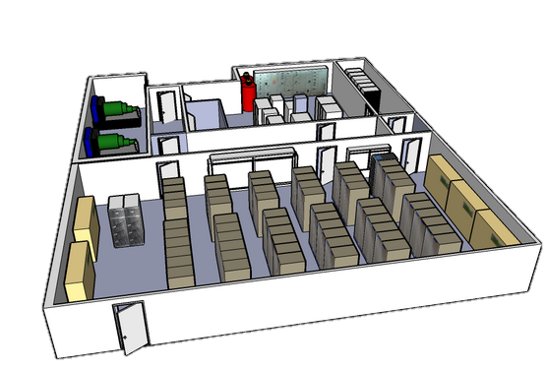
Failures, Failures, Failures
GFS paper: “Component failures are the norm rather than the exception.”
Failure types:
Disk errors and failures
DataNode failures
Switch/Rack failures
NameNode failures
Datacenter failures
DataNode
NameNode

Slide 26
Open Source version of GFS
There is an open source version called Hadoop Distributed File System (HDFS). More on Hadoop later.

Slide 27
What about indexes?
GFS does not support indexes out of the box!
When is it OK not to have them as an option?
How does it affect workloads?
What about workloads that need them?

Slide 28
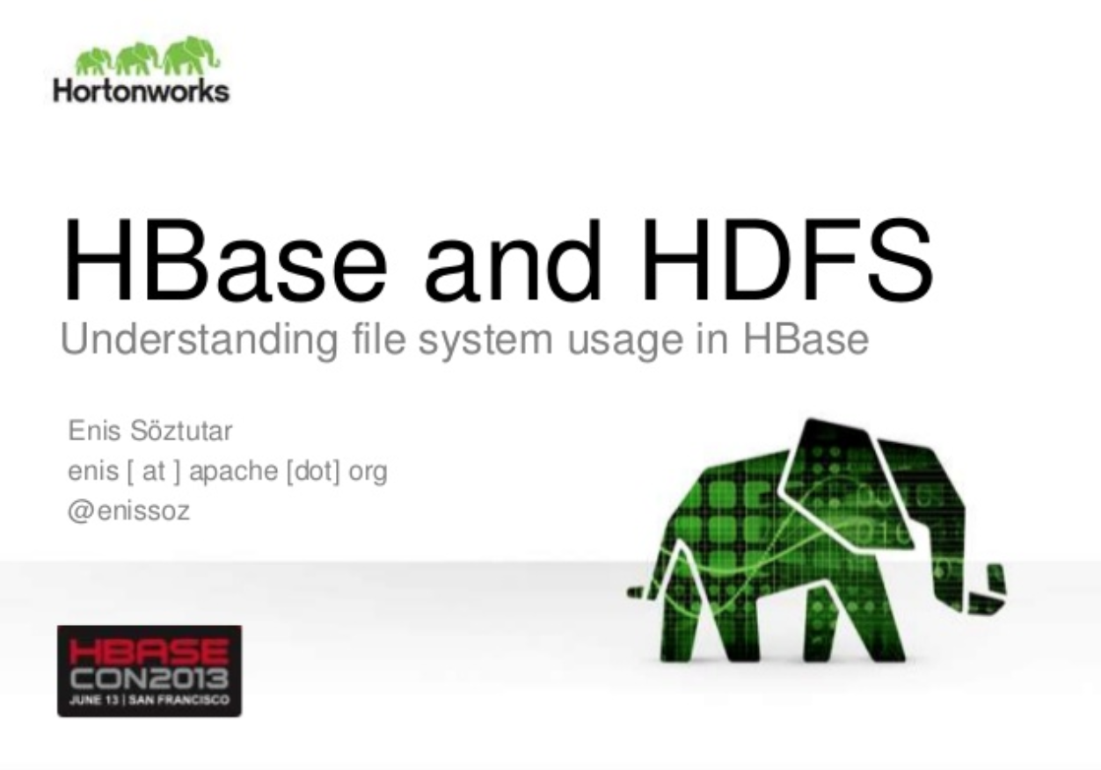
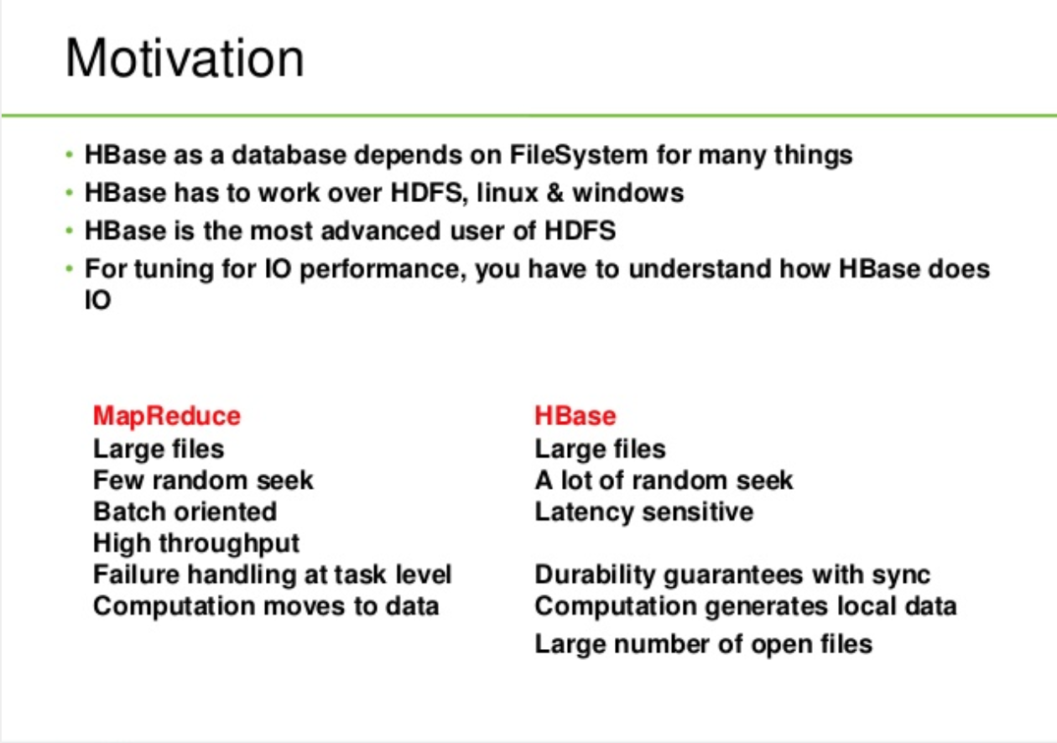
What about indexes?
GFS does not support indexes out of the box!
When is it OK not to have them as an option?
How does it affect workloads?
What about workload that need them?
https://www.slideshare.net/enissoz/hbase-and-hdfs-understanding-filesystem-usage slide 33

Slide 29
GFS Summary
Store large, immutable (append-only) files
Scalability
Reliability
Availability
Append-only, no indices
Note on another buzzword:
Cloudera & other industry vendors popularized the buzzword “Data Lake” – basically just another name for HDFS.

Slide 30

Google Datacenter
How do we program this thing?

Slide 31
Traditional Network Programming
Message-passing between nodes (MPI, RPC, etc)
Hard to do at scale:
How to split problem across nodes?
Important to consider network and data locality
How to deal with failures?
If a typical server fails every 3 years, a 10,000-node cluster sees 10 faults/day!
Even without failures: stragglers (a node is slow)
Not popular

Slide 32
Data-Parallel Models
Restrict the programming interface so that the system can do more automatically
“Here’s an operation, run it on all of the data”
I don’t care where it runs (you schedule that)
In fact, feel free to run it twice on different nodes
Similar to “declarative programming” in databases

Slide 33
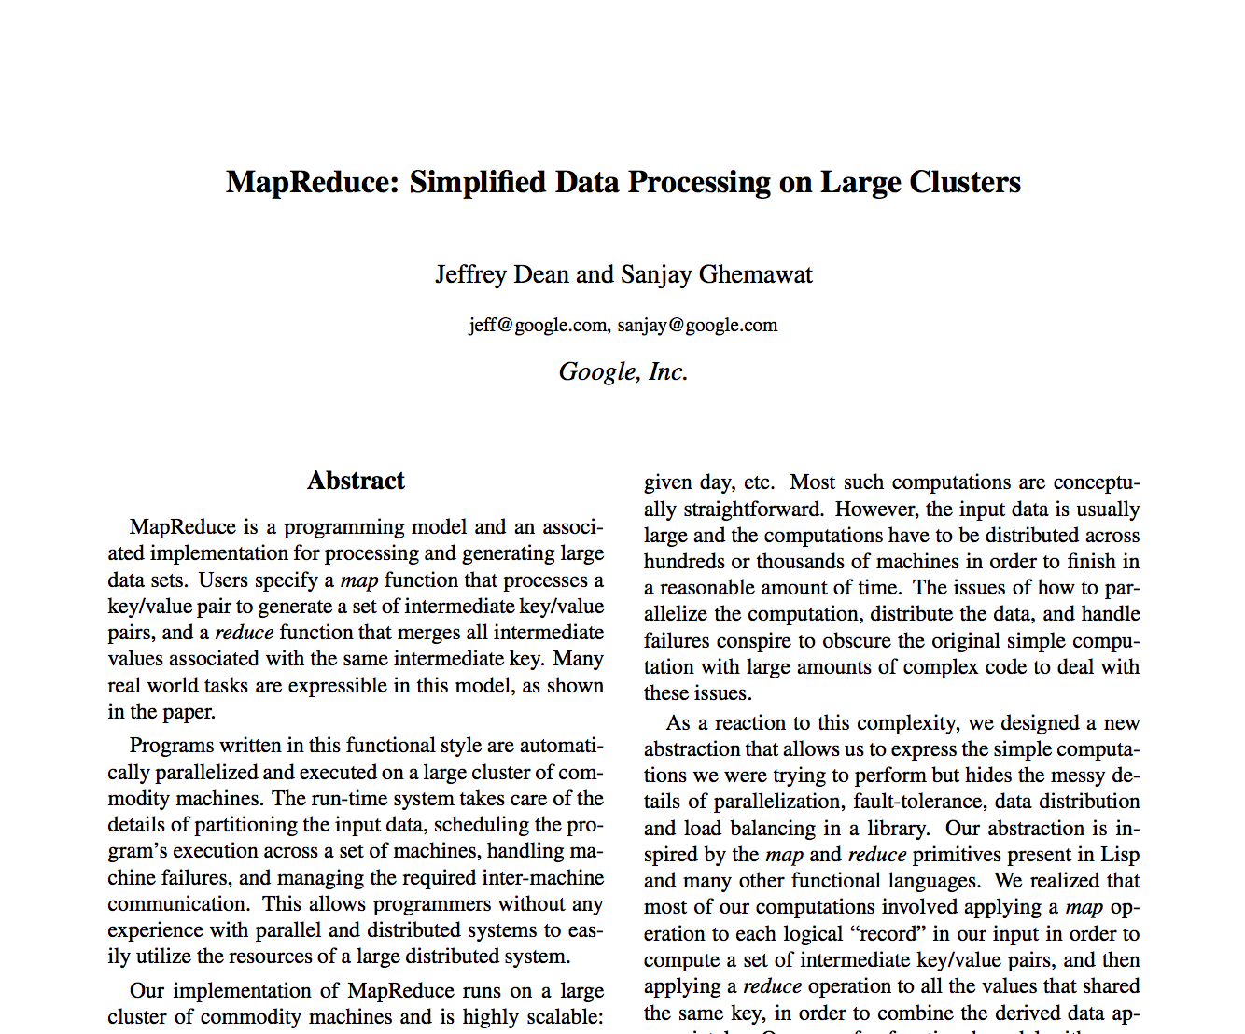
2004

Slide 34

[REVIEW] Summary: Kinds of Parallelism
Inter-Query
Intra-Query
Inter-Operator
Intra-Operator (partitioned)
pipeline
bushy
Most of Big Data (Hadoop, Spark, etc.)

Slide 35
MapReduce Programming Model
Data type: key-value records
Map function:
(K_{in}, V_{in}) -> list(K_{inter}, V_{inter})
Reduce function:
(K_{inter}, list(V_{inter})) -> list(K_{out}, V_{out})

Slide 36
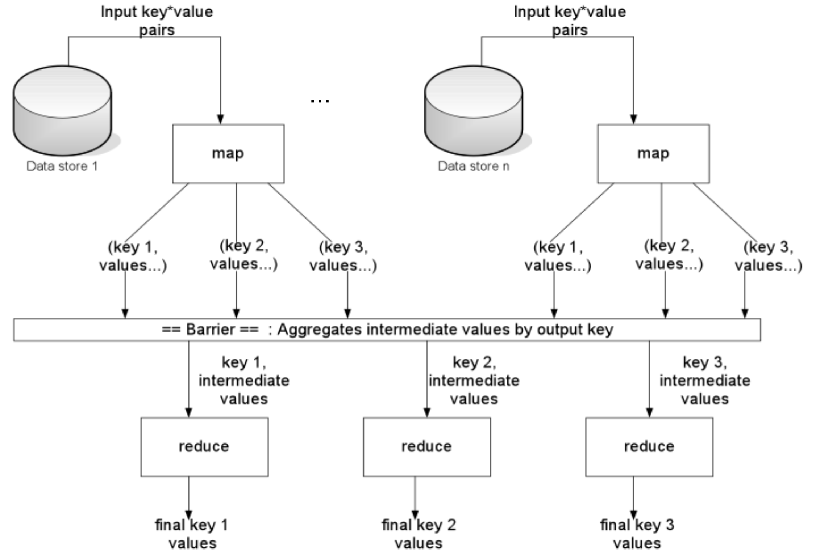
Notes:
Default Partitioner is HashPartitioner

Slide 37
Hello World of Big Data: Word Count
Input
Map
Shuffle & Sort
Reduce
Output
the, 1
brown, 1
fox, 1
the quick
brown fox
brown, 2
fox, 2
how, 1
now, 1
the, 3
Map
Reduce
the, 1
fox, 1
the, 1
the fox ate the mouse
Map
quick, 1
how, 1
now, 1
brown, 1
ate, 1
cow, 1
mouse, 1
quick, 1
ate, 1
mouse, 1
Reduce
how now
brown cow
Map
cow, 1

Slide 38
MapReduce Execution
Automatically split work into many small tasks
Send map tasks to nodes based on data locality
Load-balance dynamically as tasks finish

Slide 39
MapReduce Fault Recovery
If a task fails, re-run it and re-fetch its input
Requirement: input is immutable
If a node fails, re-run its map tasks on others
Requirement: task result is deterministic & side effect is idempotent

Slide 40
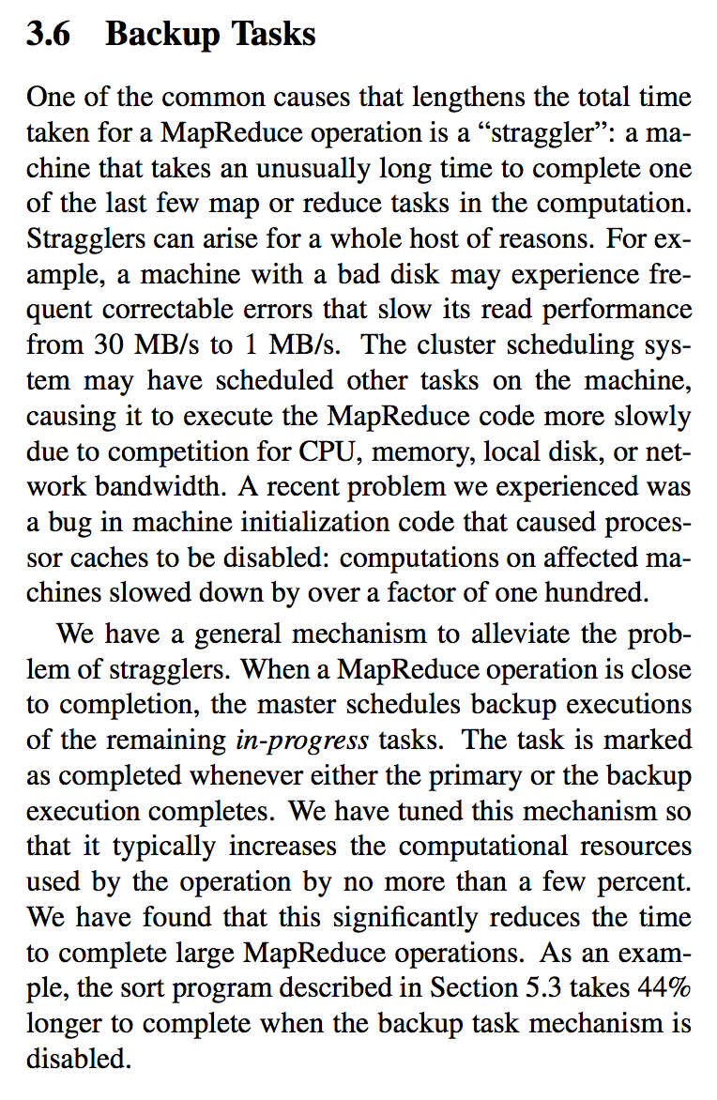
Dealing with Stragglers
Misconfigured/broken nodes = slow tasks
What’s the fix?
”Backup Tasks” = launch 2nd copy of slowest tasks on another node
44% speedups in MR paper
What are requirements for this to work?
How do you define slow?
Cost? Backup tasks are not free, why?
Notes:
In Figure 3 (b), we show an execution of the sort pro- gram with backup tasks disabled. The execution flow is similar to that shown in Figure 3 (a), except that there is a very long tail where hardly any write activity occurs. After 960 seconds, all except 5 of the reduce tasks are completed. However these last few stragglers don’t fin- ish until 300 seconds later. The entire computation takes 1283 seconds, an increase of 44% in elapsed time.
Requirement: task result is deterministic & side effect is idempotent
Not free because shared network bandwidth in data centers

Slide 41
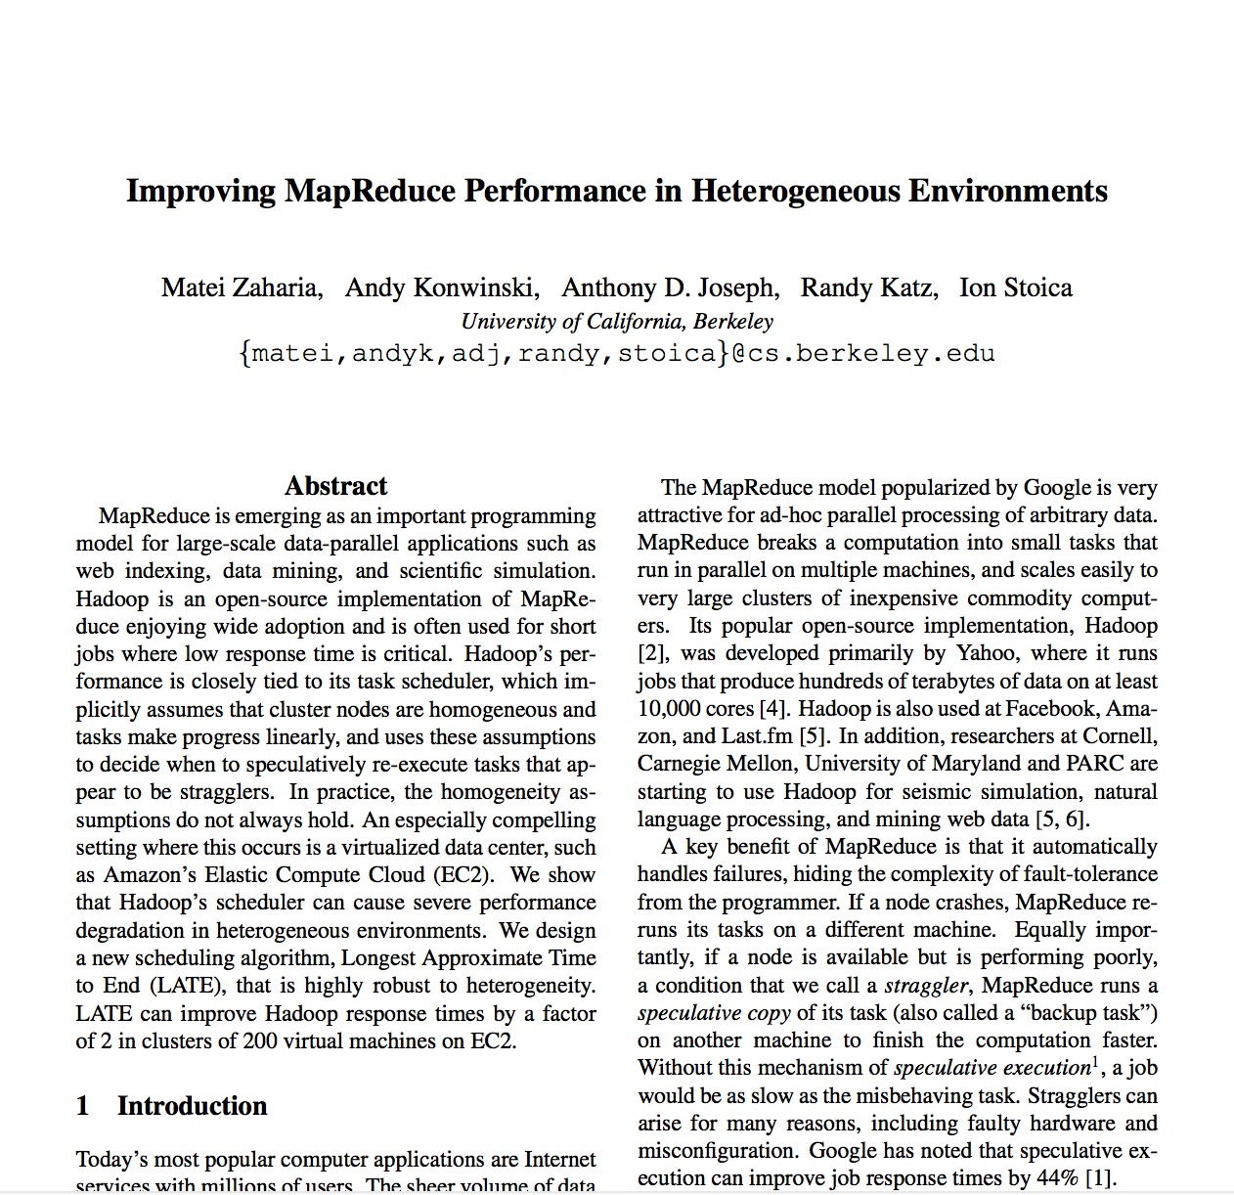

Slide 42
MapReduce Summary
By providing a data-parallel model, MapReduce greatly simplified cluster computing:
Automatic division of job into tasks
Locality-aware scheduling
Load balancing
Recovery from failures & stragglers w/ backup tasks
Also flexible enough to model a lot of workloads…

Slide 43
MapReduce Summary (continued)
Focused on intra-operator parallelism
Allows for simple mid-query fault tolerance
Allows for Straggler handling

Slide 44
Hadoop
Open-sourced by Yahoo!
modeled after the two Google papers
Two components:
Storage: Hadoop Distributed File System (HDFS)
Compute: Hadoop MapReduce
Huge investment by VCs: three large, well-funded companies & ~6 other distributions
Cloudera: $1B in funding, IPO this year
Hortonworks: $248M in funding, IPO last year
MapR: $280M in funding
Distributions (pre-consolidation): Amazon, Microsoft, Intel, Teradata, IBM, EMC/Pivotal

Slide 45
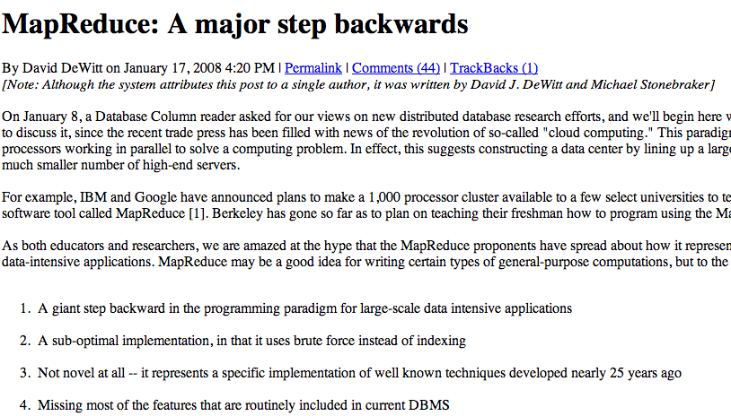

Slide 46
MapReduce Challenge: Programmability
Most real applications require multiple MR steps
Google indexing pipeline: 21 steps
Analytics queries (e.g. count clicks & top K): 2 – 5 steps
Iterative algorithms (e.g. PageRank): 10’s of steps
Multi-step jobs create spaghetti code
21 MR steps -> 21 mapper and reducer classes
Lots of boilerplate code per step
MR Jobs as execution primitives that can be composed by compiling higher layer abstractions...

Slide 47




Higher Level Frameworks
SELECT count(*) FROM users
In reality, 90+% of MR jobs are generated by Hive SQL
A = load 'foo';
B = group A all;
C = foreach B generate COUNT(A);

Slide 48
Problems with MapReduce
Programmability
We covered this earlier …
Performance
Each MR job writes all output to disk
Lack of more primitives such as data broadcast

Slide 49
Agenda
What is Big Data?
Business Use Cases
GFS, MapReduce, Hadoop
Spark
What’s different between Big Data and Databases?

Slide 50
Spark
Started in Berkeley in 2010; donated to Apache Software Foundation in 2013
Programmability: Domain Specific Language in Scala / Java / Python / R
Functional transformations on collections
5 – 10X less code than MR
Interactive use from Scala / Python REPL
Performance:
General DAG of tasks (i.e. multi-stage MR)
Richer primitives: in-memory cache, torrent broadcast, etc
Can run 10 – 100X faster than MR

Slide 51
Programmability
Full Google WordCount:
#include "mapreduce/mapreduce.h"
// User’s map function
class SplitWords: public Mapper {
public:
virtual void Map(const MapInput& input)
{
const string& text = input.value();
const int n = text.size();
for (int i = 0; i < n; ) {
// Skip past leading whitespace
while (i < n && isspace(text[i]))
i++;
// Find word end
int start = i;
while (i < n && !isspace(text[i]))
i++;
if (start < i)
Emit(text.substr( start,i-start),"1");
}
}
};
REGISTER_MAPPER(SplitWords);
// User’s reduce function
class Sum: public Reducer {
public:
virtual void Reduce(ReduceInput* input)
{
// Iterate over all entries with the
// same key and add the values
int64 value = 0;
while (!input->done()) {
value += StringToInt(
input->value());
input->NextValue();
}
// Emit sum for input->key()
Emit(IntToString(value));
}
};
REGISTER_REDUCER(Sum);
int main(int argc, char** argv) {
ParseCommandLineFlags(argc, argv);
MapReduceSpecification spec;
for (int i = 1; i < argc; i++) {
MapReduceInput* in= spec.add_input();
in->set_format("text");
in->set_filepattern(argv[i]);
in->set_mapper_class("SplitWords");
}
// Specify the output files
MapReduceOutput* out = spec.output();
out->set_filebase("/gfs/test/freq");
out->set_num_tasks(100);
out->set_format("text");
out->set_reducer_class("Sum");
// Do partial sums within map
out->set_combiner_class("Sum");
// Tuning parameters
spec.set_machines(2000);
spec.set_map_megabytes(100);
spec.set_reduce_megabytes(100);
// Now run it
MapReduceResult result;
if (!MapReduce(spec, &result)) abort();
return 0;
}

Slide 52
Programmability
Spark WordCount:
val file = spark.textFile(“hdfs://...”)
val counts = file.flatMap(line => line.split(“ ”)) .map(word => (word, 1)) .reduceByKey(_ + _) counts.save(“out.txt”)

Slide 53
Performance
Time per Iteration (s)

Slide 54
Spark stack

Slide 55
Top Applications
Notes:
What was before?

Slide 56








Spark has 1000s of users

Slide 57
“Spark is the Taylor Swift
of big data software.”
- Derrick Harris, Fortune

Slide 58
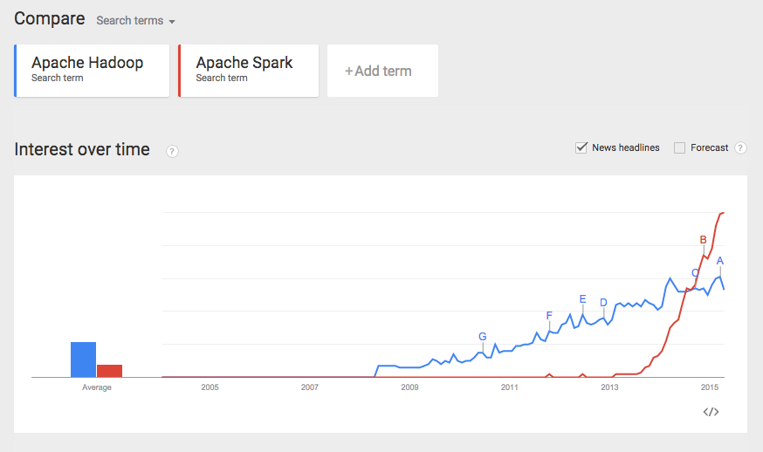
Note： not a scientific comparison.

Slide 59
Where does Spark fit in?

Slide 60
Where/When Should I Use Spark?
I want to know how much of my product was sold per country.

Slide 61
Where/When Should I Use Spark?
I want to know how much of my product was sold per country.

Slide 62
Where/When Should I Use Spark?
I want to serve the user preferences of a customer when they click “Settings” on my website.

Slide 63
Where/When Should I Use Spark?
I want to serve the user preferences of a customer when they click “Settings” on my website.

Slide 64
Where/When Should I Use Spark?
I want to extract features from thousands of newspaper articles and classify whether an article belongs in the “Economy” or “Politics” section.

Slide 65
Where/When Should I Use Spark?
I want to extract features from thousands of newspaper articles and classify whether an article belongs in the “Economy” or “Politics” section.

Slide 66
Where/When Should I Use Spark?
Given a map, I want to figure out the fastest way to get from point A to point B.

Slide 67
Where/When Should I Use Spark?
Given a map, I want to figure out the fastest way to get from point A to point B.

Slide 68
Where/When Should I Use Spark?
I want to centralize all the data my sensors are generating all around the world. I would like to push my data somewhere from these sensors.

Slide 69
Where/When Should I Use Spark?
I want to centralize all the data my sensors are generating all around the world. I would like to push my data somewhere from these sensors.

Slide 70
Where/When Should I Use Spark?
I have sensors generating data every 15 seconds. I want to analyze the data but first enrich it with regional information and aggregate per region in 15 minute windows.

Slide 71
Where/When Should I Use Spark?
I have sensors generating data every 15 seconds. I want to analyze the data but first enrich it with regional information and aggregate per region in 15 minute windows.

Slide 72
Spark history
RDD research
paper
Structured Streaming
Code generation
Vectorization
Spark 1.0 & libraries
(SQL, ML, GraphX)
2010
2013
2015
2012
2014
2016
Databricks started
& donated to ASF
started
@
Berkeley
DataFrames
Tungsten
ML Pipelines
Dataset
R

Slide 73


Scaling Spark users
Early adopters
Data Scientists
Statisticians
R users
PyData
…
Users
Understand
MapReduce
& functional APIs

Slide 74
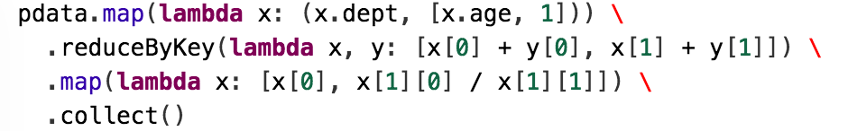
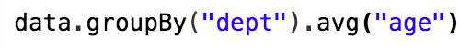

Slide 75
DataFrames in Spark
Distributed data frame abstraction for Java, Python, R, Scala
Similar APIs as single-node tools (Pandas, dplyr), i.e. easy to learn
> head(filter(df, df$waiting < 50)) # an example in R
## eruptions waiting
##1 1.750 47
##2 1.750 47
##3 1.867 48

Slide 76






Execution Steps
SQL
Data Frames
Logical Plan
Optimizer
Physical Plan
Code
Generator
RDDs
Data
Source
API
Catalog
…

Slide 77
DataFrame API
DataFrames hold rows with a known schema and offer relational operations on them through a DSL
val users = spark.sql(“select * from users”)
val massUsers = users(users(“country”) === “ES”)
massUsers.count()
massUsers.groupBy(“name”).avg(“age”)
Expression AST

Slide 78
Spark RDD Execution
Java/Scala
frontend
opaque closures
(user-defined functions)
Python
frontend
JVM
backend
Python
backend

Slide 79
Spark DataFrame Execution
DataFrame
frontend
Logical Plan
Intermediate representation for computation
Catalyst
optimizer
Physical execution

Slide 80
Spark DataFrame Execution
Python
DF
Java/Scala
DF
SQL
Simple wrappers to create logical plan
Logical Plan
Intermediate representation for computation
Catalyst
optimizer
Physical
execution

Slide 81
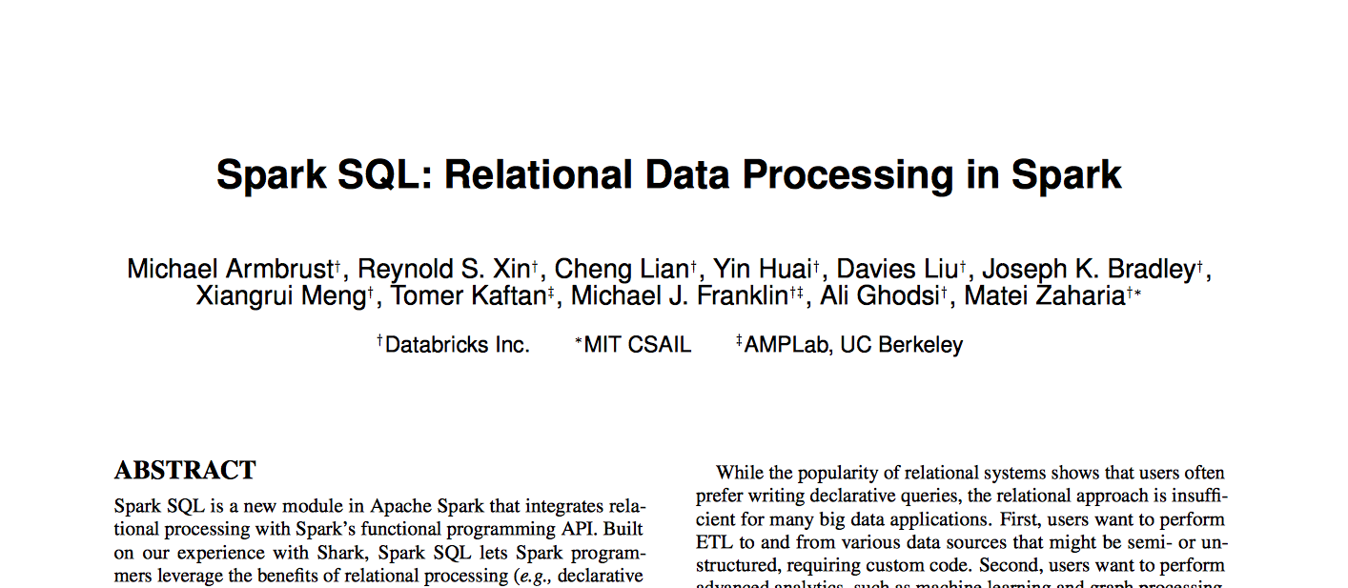
DataFrames and Spark SQL
Efficient library for structured data (data with a known schema)
Two interfaces: SQL for analysts + apps, DataFrames for programmers
Optimized computation and storage, similar to RDBMS
SIGMOD 2015

Slide 82
Execution Steps
SQL
Data Frames
Logical Plan
Optimizer
Physical Plan
Code
Generator
RDDs
Data
Source
API
Catalog
…

Slide 83
DataFrame API
DataFrames hold rows with a known schema and offer relational operations on them through a DSL
val users = spark.sql(“select * from users”)
val massUsers = users(users(“state”) === “CA”)
massUsers.count()
massUsers.groupBy(“name”).avg(“age”)
Expression AST

Slide 84
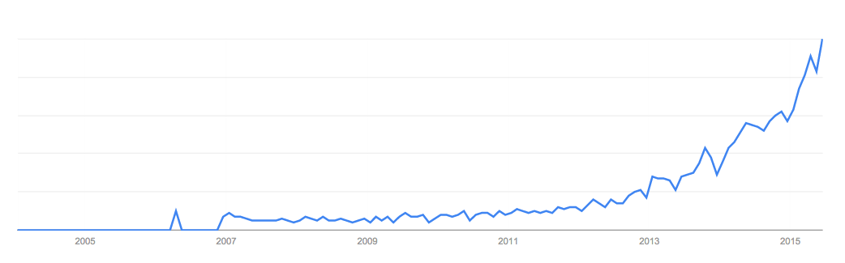
Why DataFrames?
Based on data frame concept in R and Python
Spark is the first to make this a declarative API
Integrates with other data science libraries
MLlib, GraphFrames, …
Google trends for “data frame”

Slide 85
Other High-Level APIs
Machine Learning Pipelines
Modular API based on scikit-learn
GraphFrames
Relational + graph operations
Structured Streaming
Declarative streaming API in Spark 2.0
tokenizer
TF
LR
DataFrame
model
Many high-level data science APIs can be declarative

Slide 86




Batch Execution on Spark SQL
Planner
DataFrame/
Dataset
Logical Plan
Helluvalot of magic!
SQL AST
Analysis
Logical
Optimization
Physical
Planning
Code
Generation
DataFrame
Unresolved Logical Plan
Logical Plan
Optimized Logical Plan
Physical Plans
Cost Model
Selected Physical Plan
RDDs
Dataset
Catalog

Slide 87
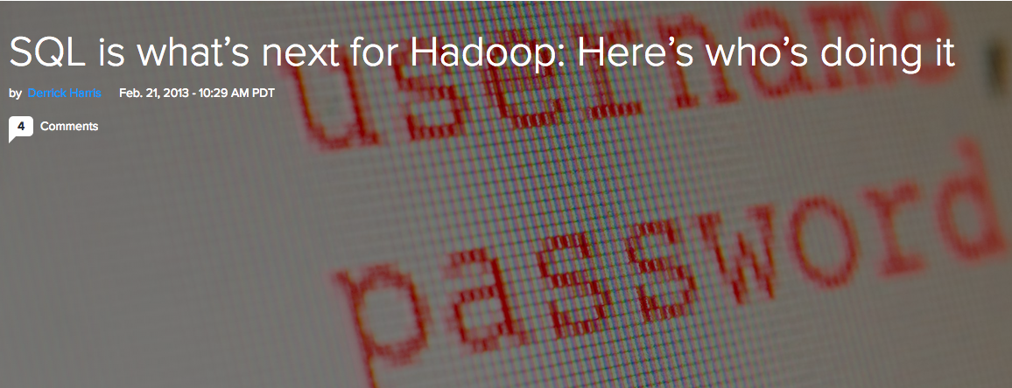
Return of SQL

Slide 88
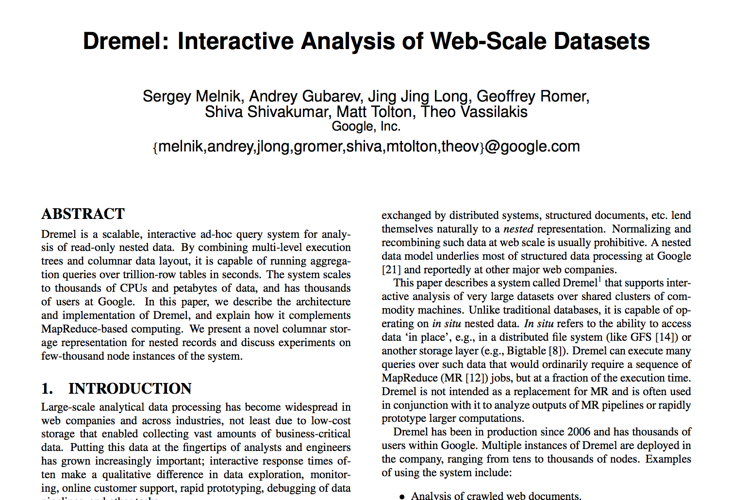
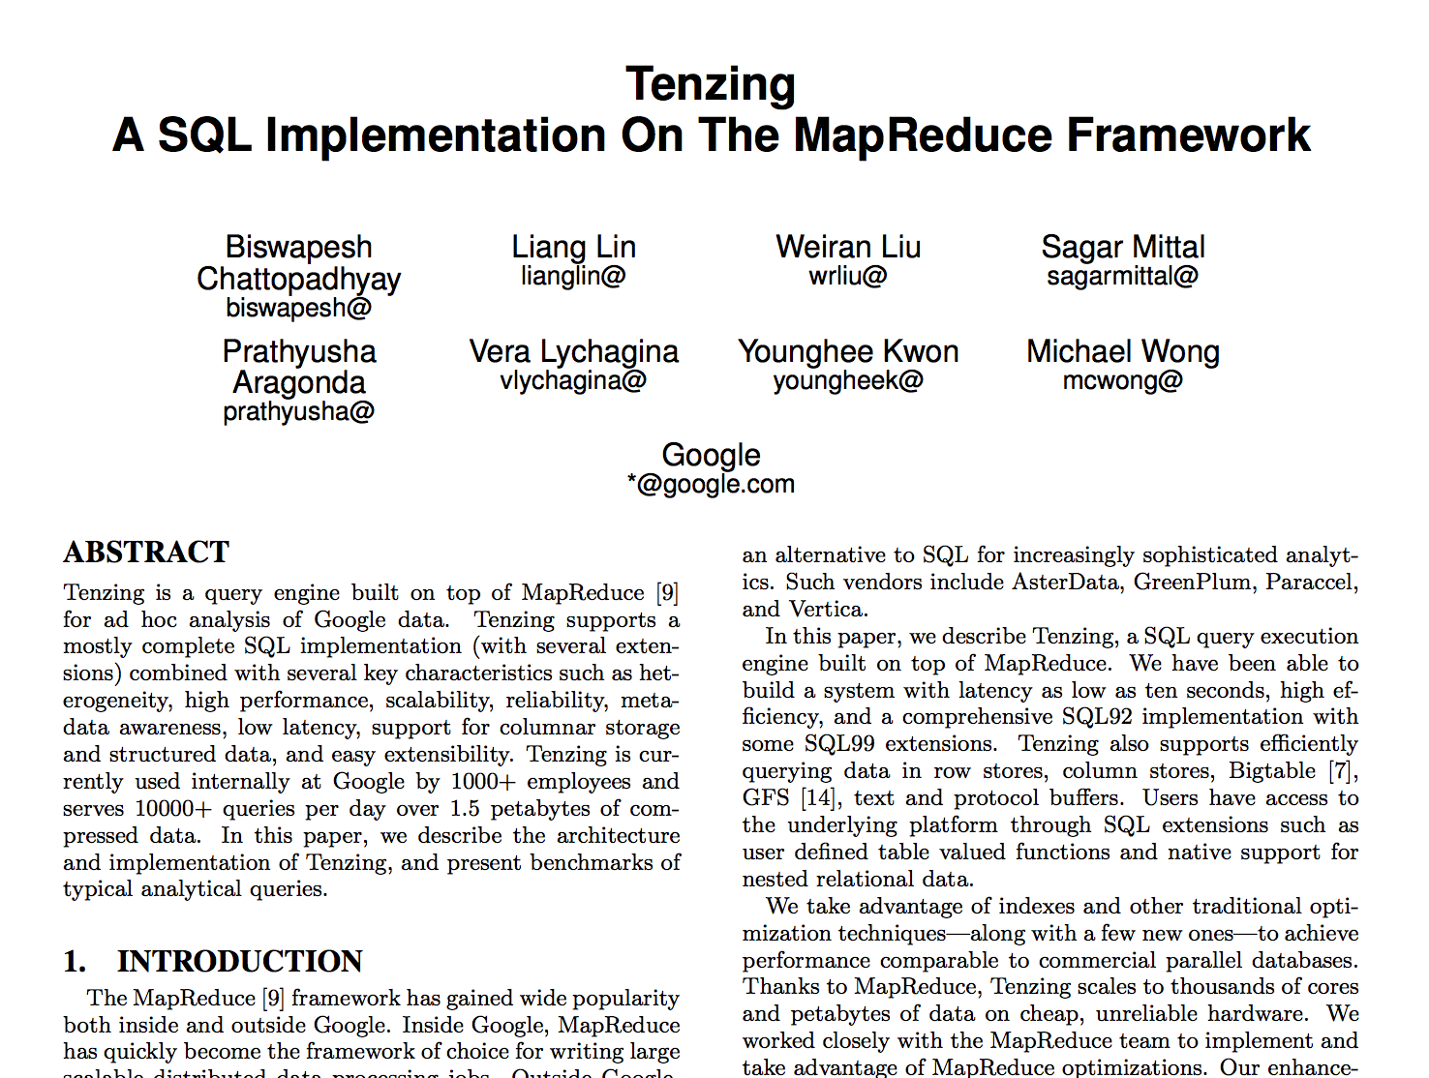
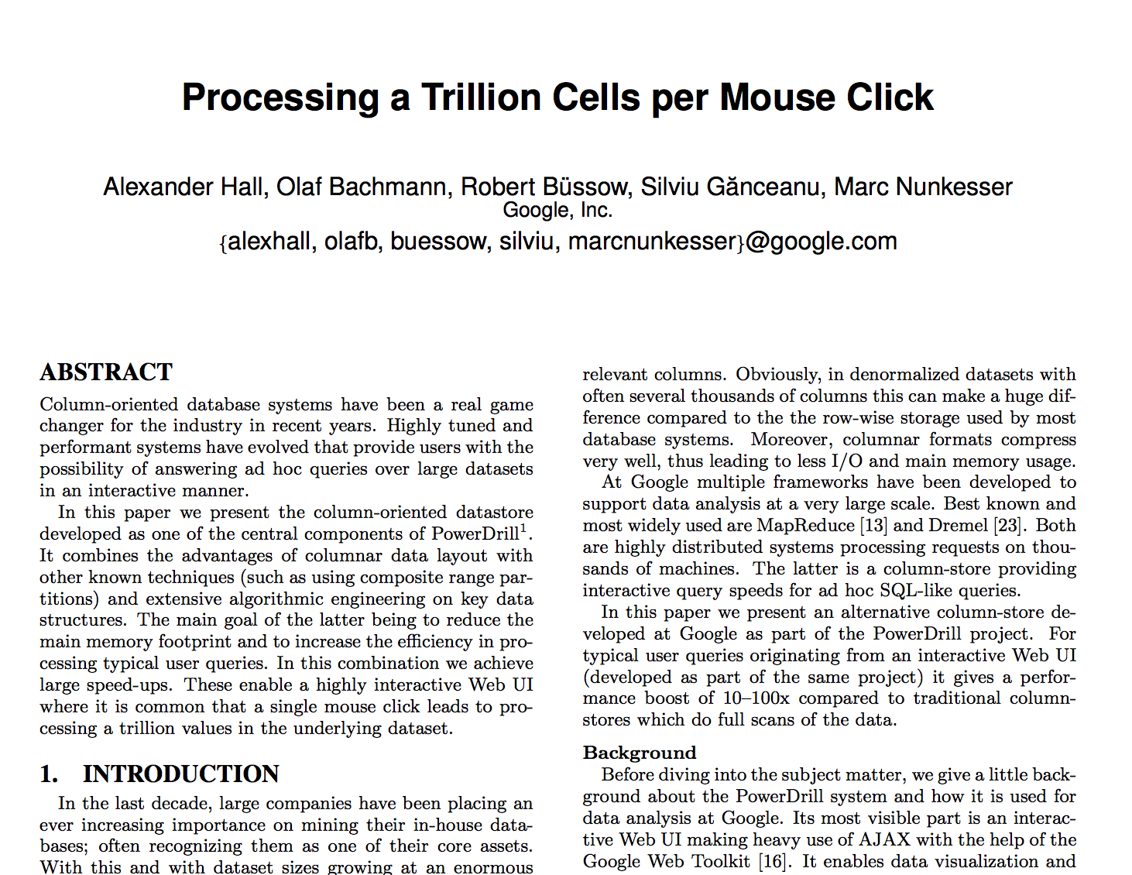

Slide 89
Why SQL?
Almost everybody knows SQL
Easier to write than MR and Spark for analytic queries
Lingua franca for data analysis tools (business intelligence, etc)
Schema is useful (key-value is limited)

Slide 90
What’s really different?
SQL on Big Data (Hadoop/Spark) vs SQL in Databases?
Two perspectives:
Flexibility in data and compute model
Fault-tolerance

Slide 91
Traditional Database Systems (Monolithic)
Applications
SQL
Physical Execution Engine (Dataflow)
Storage Manager
One way (SQL) in/out and data must be structured

Slide 92
Big Data Systems (Layered)
Applications
SQL
DataFrame
ML
Data-Parallel Engine (Spark, MR)
General Storage (HDFS, S3, etc)
Decoupled storage, low vs high level compute
Structured, semi-structured, unstructured data
Schema on read, schema on write

Slide 93
Evolution of Database Systems Decouple Storage from Compute
Traditional
2014 - 2016
Applications
Applications
SQL
SQL
Physical Execution Engine (Dataflow)
Physical Execution Engine (Dataflow)
Storage Manager
General Storage (HDFS)
IBM Big Insight
Oracle
EMC Greenplum
…
support for nested data (e.g. JSON)

Slide 94
Perspective 2: Fault Tolerance
Database systems: coarse-grained fault tolerance
If fault happens, fail the query (or rerun from the beginning)
MapReduce: fine-grained fault tolerance
Rerun failed tasks, not the entire query

Slide 95
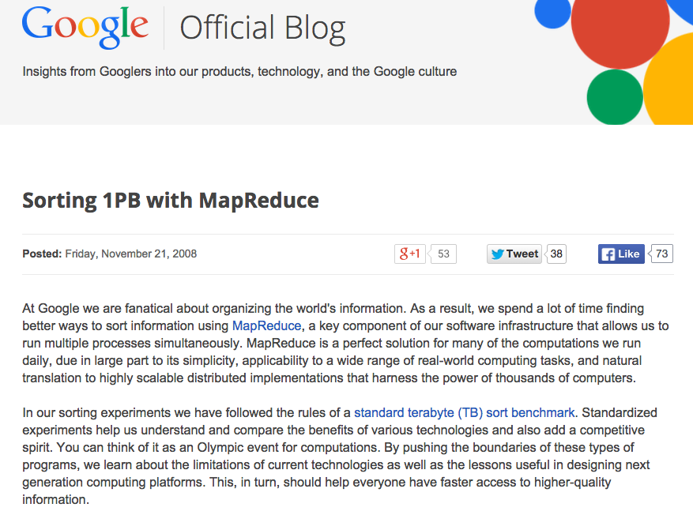
We were writing it to 48,000 hard drives (we did not use the full capacity of these disks, though), and every time we ran our sort, at least one of our disks managed to break (this is not surprising at all given the duration of the test, the number of disks involved, and the expected lifetime of hard disks).

Slide 96
MapReduce Checkpointing-based Fault Tolerance
Checkpoint all intermediate output
Replicate them to multiple nodes
Upon failure, recover from checkpoints
High cost of fault-tolerance (disk and network I/O)
Necessary for PBs of data on thousands of machines
What if I have 20 nodes and my query takes only 1 min?

Slide 97
Spark Unified Checkpointing and Rerun
Simple idea: remember the lineage to create an RDD, and recompute from last checkpoint.
When fault happens, query still continues.
When faults are rare, no need to checkpoint, i.e. cost of fault-tolerance is low.

Slide 98
BD vs DB: What’s Really Different?
Monolithic vs layered storage & compute
Databases becoming more layered
Although Big Data still far more flexible than DB
Fault-tolerance
Databases mostly coarse-grained fault-tolerance, assuming faults are rare
Big Data mostly fine-grained fault-tolerance, with new strategies in Spark to mitigate faults at low cost

Slide 99
Convergence
Databases evolving towards Big Data
Decouple storage from compute
Provide alternative programming models
Semi-structured data (JSON, XML, etc)
Big Data evolving towards Databases
Schema beyond key-value
Separation of logical vs physical plan
Query optimization
More optimized storage formats

Slide 100
What we talked about today?
3 Vs of Big Data
GFS & MapReduce & Hadoop
Spark (RDD, DataFrame)
Convergence of Big Data and Databases

Slide 101
Thanks! Questions?
andy@databricks.com
Many slides re-used from:
Burak Yuvaz, Databricks. CS186 Spring 2017
Reynold Xin, Databricks. CS186 2016
Matei Zaharia, Databricks. Processing Big Data with Small Programs
Michael Franklin, SQL, NoSQL, NewSQL?. CS186 2013

Slide 102
Whole-stage Codegen
Fusing operators together so the generated code looks like hand optimized code:
Identify chains of operators (“stages”)
Compile each stage into a single function
Functionality of a general purpose execution engine; performance as if hand built system just to run your query
See paper Efficiently Compiling Efficient Query Plans for Modern Hardware, Neumann, VLDB 2011

Slide 103
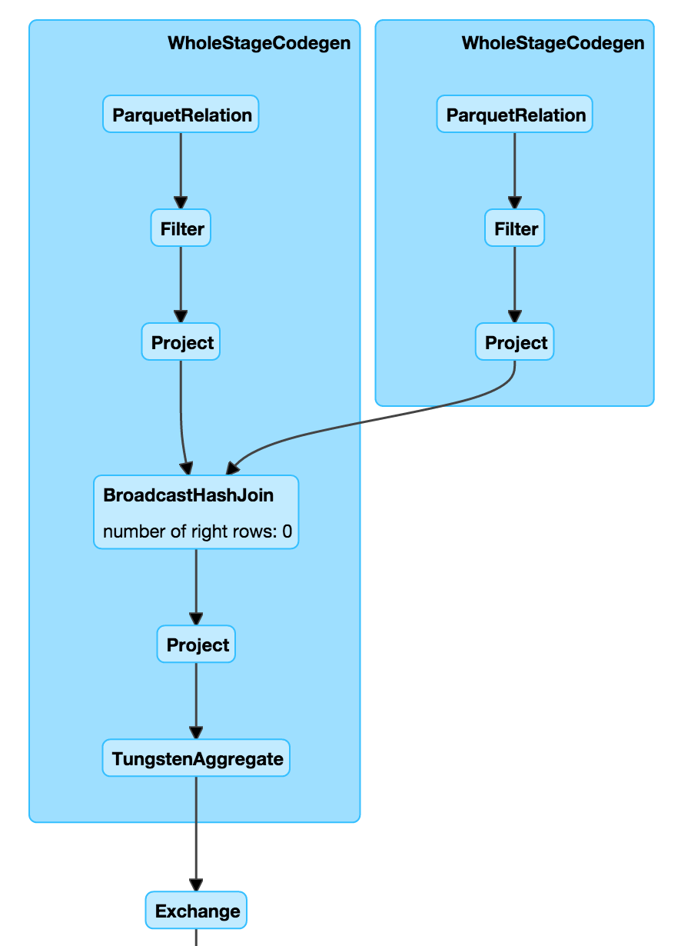
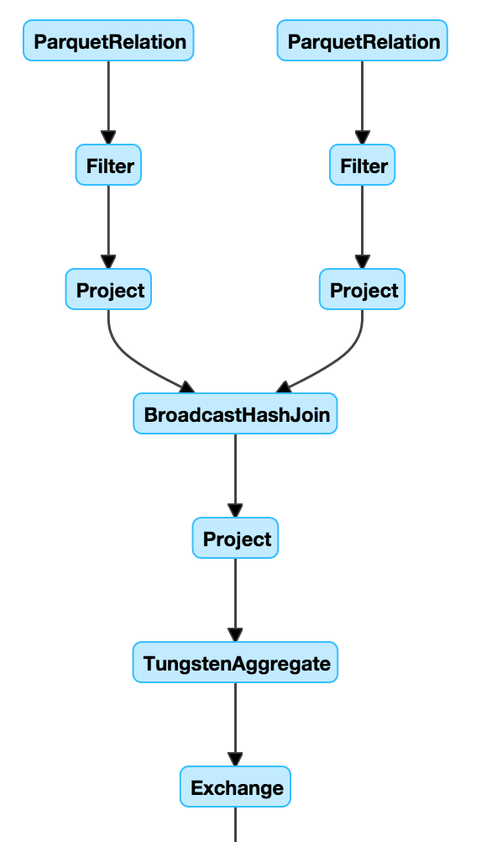
Whole-stage Codegen: Planner

Slide 104
Whole-stage Codegen: Spark as a “Compiler”
Aggregate
long count = 0;
for (ss_item_sk in store_sales) {
if (ss_item_sk == 1000) {
count += 1;
}
}
Project
Filter
Scan

Slide 105
Vectorized Decoding
Vectorized decoding
Parquet + built-in cache
Inspired by X100/Vectorwise
Parquet in 1.6
11M
rows/s
Parquet in 2.0
90M
rows/s

Slide 106
War Stories

Slide 107
Pipelines will fail

Slide 108
Troubleshooting
The audit logging pipeline fails several times a month. Usually it succeeds on the retries. Here are some of the common error cases. These error cases can be found in the digest emails sent by the pipeline:
Caused by: java.io.IOException: /path/date=2016-10-25/blah.gz.parquet already exists
This is due to S3 eventual consistency. The retry should succeed
IllegalStateException: Cannot call methods on a stopped SparkContext.
Something happened to the application. Probably all executors were lost and Spark killed the application. This is an open source bug and should be fixed soon. Retries with on-demand instances should succeed.
Job 25 cancelled part of cancelled job group 3155545341997344370_5242158252298278457_job-84798-run-1-action-88481
Job seems to have timed out. May want to increase job timeout or use more instances, as load for this day may be high

Slide 109
java.io.IOException: Failed to delete /path/date=2016-10-10/blah.gz.parquet
Another S3 eventual consistency problem. Retry should succeed
Caused by: org.apache.spark.SparkException: Job aborted due to stage failure: Task 256 in stage 76.0 failed 4 times, most recent failure: Lost task 256.3 in stage 76.0 (TID 39492, 10.0.78.66): java.io.IOException: No space left on device
Caused by too much shuffle. Increasing EBS volume should help.
Caused by: org.apache.spark.SparkException: Job aborted due to stage failure: Task 92 in stage 5.0 failed 4 times, most recent failure: Lost task 92.3 in stage 5.0 (TID 16616, 10.0.27.18): java.io.IOException: Stream is corrupted
Caused by EC2 instances in bad states. Workarounds will be merged to new version of Spark (2.1 or newer). Currently (2016/11/30) we use a customized spark image in prod job which seems fixed the issue.

Slide 110
Bad data problems
One day one table had 8 columns
The next day it had 32 columns
What happened?

Slide 111
Customer Stories
Attempting to join ~400M rows x ~2B rows
Keep hitting out of memory issues
After join get 4 Trillion rows

Slide 113
Customer Stories
Customer job spuriously fails with `ExecutorLostFailure`
16/09/29 17:36:44 WARN AkkaRpcEndpointRef: Error sending message [message = Heartbeat(18,[Lscala.Tuple2;@79d26749,BlockManagerId(18, 10.49.188.112, 37861))] in 1 attempts org.apache.spark.rpc.RpcTimeoutException: Futures timed out after [120 seconds]. This timeout is controlled by spark.rpc.askTimeout at org.apache.spark.rpc.RpcTimeout.org$apache$spark$rpc$RpcTimeout$$createRpcTimeoutException(RpcEnv.scala:214)

Slide 114
They are running an iterative ML algorithm. The futures timed out errors all seem to be happening around the "collect" phase
They have 50 workers -> 400 tasks. Each task is trying to send about 25 MB to the driver. Total bytes received by the driver will be around 25 * 400 -> 10 GB.
The driver starts GC'ing after several iterations (as it received 10 GB on the previous iterations). GC + Network saturation prevent the Driver and Master from acknowledging the Executor heartbeats.
Executors get killed because the master didn't receive any heartbeats (even though the executors tried for 2 minutes)
Job fails because they use rdd.localCheckpoint

Slide 115
groupByKey + collect causing large network traffic to Driver
Replace with treeAggregate

Slide 116
Lessons Learned

Slide 117
Unit testing
#1 thing you will do when working in industry
Helps set contracts
Makes sure other people don’t break those contracts
Good to learn frameworks like jUnit, scalatest, python unittest, mocha in JS

Slide 118
Solve problems at the source
Requires clearly defining the problem & understanding the root cause
Sometimes not easy, may be time consuming
Doing it right has better rate of return

Slide 119
Aggregate classes of problems and try building holistic solutions
Customers will want faster horses. Build them a car instead
Try solving bigger picture problem rather than manifestations of problem
Otherwise end up with fragmented solutions that work somewhere but not everywhere

Slide 120
Leverage what’s out there
Someone probably has faced an issue you’re facing
Someone probably has already solved the issue you’re facing
Use that someone’s work
Don’t reinvent the wheel

Slide 121
Scope work as much as you can ahead of time
Figure out requirements
Provide the simplest possible solution that meets these requirements
KISS (Keep it simple, stupid)
Think about evolvability over time

Slide 122
Extra Spark Slides

Slide 123
Why is it so hard?
Data is a mess
Siloed across many sources
Saved in different formats
Always has “bad” values
Evolves over time
Scalability is an issue
Require fault tolerance
Data skew is a pain

Slide 124
Why is it so hard?
Pipelines are growing complex
Anomaly detection
Learn models offline
Use online + continuous learning
IoT events from Kafka
event stream
ETL into long term storage
Prevent data loss
Prevent duplicates
Status monitoring
Handle late data
Aggregate on windows on event time
Interactively debug issues
- consistency

Slide 125
The hard part of ML
https://papers.nips.cc/paper/5656-hidden-technical-debt-in-machine-learning-systems.pdf

Slide 126
Apache® Spark™ to the rescue
Unified engine for large-scale data processing
Batch / Offline
Streaming / Online
Fast
Easy to use
Great APIs
Available in Python, Scala, Java, R, SQL
Huge Ecosystem
1,000+ contributors on GitHub
Can run Standalone, on Yarn, on Mesos, on the Cloud, on premise
Can connect to many data sources and consume many data formats
Spark Packages

Slide 127
Spark has 1000s of users

Slide 128
Cloud | On-Prem
Elastic Low cost of ownership Pay-as-you-go No up-front infrastructure burden No infra-maintenance burden | Rigid You’re in control Can customize according to niche requirements

Slide 129
Data Sources

Slide 130
Data Formats

